Slide 1
APPLICATIONS OF GRAPH THEORY IN CRYPTOGRAPHY
COURSE-
DISCRETE MATHEMATICS IT-203
TEAM MEMBERS-
ANURAG KUMAR
ROHIT TAPARIA
VANSHIKA JOLLY
INSTRUCTOR-
TRUPTI CHANDAK
Dr. BHAWANA RUDRA

Slide 2



INTRODUCTION- CRYPTOGRAPHY
Cryptography refers to secure information and communication techniques derived from mathematical concepts and a set of rule-based calculations called algorithms, to transform messages in ways that are hard to decipher. We are using Graph Theory is being used to create a secure Encryption - Decryption algorithm.
Cipher text
Plain text
Encryption algorithm
Decryption algorithm
Plain text​

Slide 3
GRAPH THEORY
Undirected Graph : An undirected Graph is denoted by G(V, E) where V is the set of vertices and E is a set of edges that connect vertices with each other. Information can be stored in each of the vertices.
Spanning tree : In Graph Theory, a spanning tree T of an undirected graph G is a subgraph that is a tree which includes all of the vertices of G, with a minimum possible number of edges.
A minimum spanning tree is a spanning tree whose sum of edge weights is as small as possible.
Weighted undirected graphs have been used to store, encode and decode the data.
Adjacency Matrix : It is a square matrix used to represent a finite graph . The elements of the matrix indicate whether pairs of vertices are adjacent or not in the graph.

Slide 4
.
The value of the matrix element in the adjacency matrix is the number of edges between those two vertices.
Prim’s Algorithm : MST can be computed using this algorithm. It can be implemented using heaps as well as adjacency matrices. In this project, we have used the matrix implementation of Prim’s Algorithm.
The idea behind Prim’s algorithm is simple, as discussed, a spanning tree means all vertices must be connected. So the two disjoint subsets of vertices(one contains the vertices already included in MST and other contains rest of the vertices) must be connected to make a Spanning Tree. And they must be connected with the minimum weight edge to make it a Minimum Spanning Tree.

Slide 5
LITERATURE SURVEY
https://www.researchgate.net/publication/269803082_Encryption_Algorithm_Using_Graph_Theory
Here is a research paper “Encryption algorithm using graph theory” by Wael Mahmoud Al Etaiwi.
https://www.researchgate.net/publication/349459366_Some_Graph-Based_Encryption_Schemes
This is a research paper “Some Graph-Based Encryption algorithms” by Shafiq Ur Rehman and Gulam Farid.
https://www.researchgate.net/publication/349459366_Some_Graph-Based_Encryption_Schemes
Research article by Baizhu Ni,Rabiha Qazi,Shaﬁq Ur Rehman and Ghulam Farid

Slide 6
LIMITATIONS AND NOVELTY
In the base paper ,only encryption of uppercase characters A-Z has been done. We plan to extend it to encryption of all characters by using a modified encoding scheme by using ASCII values rather than assigning the order of the A-Z characters as 1-26.
Since we are not limited to A-Z, the diagonal weights need to be assigned sequentially from 256 to avoid the clash of the other ASCII characters. This will be shown in the next slides.
In some cases, it is possible that the determinant of the matrix M1 can become zero. In these cases, the inverse of M1 cannot be computed. In our algorithm, we plan to throw an error in such circumstances .For now, we have assumed that such circumstances do not occur.

Slide 7
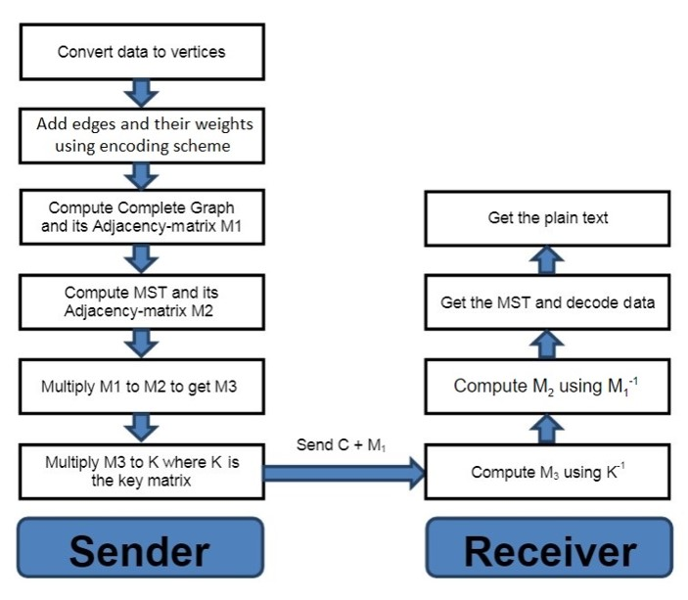
MODEL

Slide 8
Implementation of the model
Start with the character that has been used to point to the 1st character of the input string (‘A’ in our case). Then we calculate the difference between the ASCII values of the 1st character of the input string and this pointer character and assign this weight to the edge between these two vertices by adding one.
If the edge is a side of the polygon(cycle) or between the special character and the starting character, then for computing the edge weights, ASCII values of the characters are considered and the edge weight of any such edge is computed by calculating the difference between the ASCII values of the characters and then adding one to it. Calculate this difference for each edge in a cyclic manner.
The reason for adding one in the above method is to avoid the edge weight of two same characters from becoming zero. And if the edge weight becomes zero, then while computing the MST the program will consider that no edge lies between these vertices which is a wrong assumption.
If the edge is a diagonal of the polygon, then edge weights are sequentially assigned starting from 256 and increasing the weight by 1 each time.

Slide 9
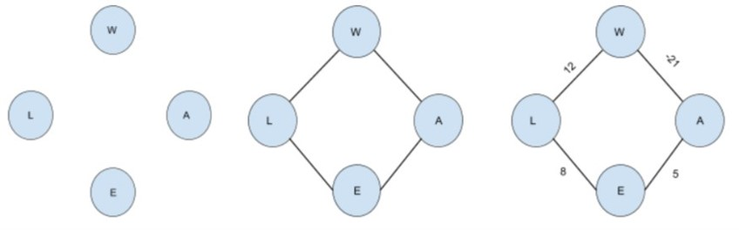
Encoding Process
Step 1: Converting characters of the message to vertices of graph
Step 2: Adding edges to form a complete cycle of the input
Step 3: Add weights to each of the edges of the cycle
Step 4: Add weights to the diagonals to create a complete graph

Slide 10
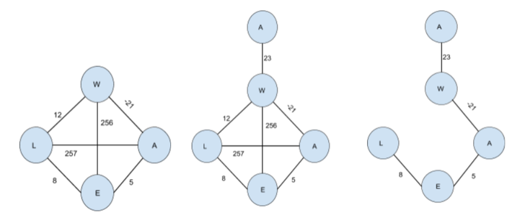
Step 5:Add a special character to indicate the starting character
Step 6: Compute MST and its adjacency matrix M2

Slide 11
Step 7: Computing Matrix M3
M₃ = M₁ * M₂
Step 8: Computing Cipher Matrix
Cipher = Key * M₃
Send ( Cipher + M₁) to Receiver

Slide 12
DECODING PROCESS
Step 1: Receive the data, compute inverse of Key
Step 2: Compute M₃ using Key⁻¹ and Cipher
M₃ = Key⁻¹ * Cipher
Step 3: Compute M2 using M1⁻¹ and M3
M₂ = M1⁻¹ * M₃
Step 4: Get the MST and decode data

Slide 13
Conclusion
We improvised on the base research paper and have explored one very good and secure technique to encrypt and decrypt data using graph theory. For now, we have used symmetric encryption, and we plan to make it asymmetric by endsem evaluation.
We plan to implement this proposed algorithm using C++ programming language. Our implementation takes the message as input. First the program encodes the input message using the encoding algorithm. Then this encoded message is passed on to the decoding module of our program. The decoding module decodes the message and finally displays the decoded message.
Notes:
Decoding done

